Slide 1

Classification Algorithm
Predicting New User Bookings
Shraddha D, Manish N, Smitha K.

Slide 2
Goal
Using a dataset of 16 basic features, predict where the user will make their first booking

Slide 3
The whole dataset contains 4 csv files:
train-users and test-users
age-gender-bkts
sessions
• id
• date-accounat-created
• date-first-booking
• gender
• age
• signup-method
• signup-flow
• language
• affiliate-channel
• affiliate-provider
• first-affiliate-tracked
• signup-app
• first-device-type
• first-browser
• country-destination
• timestamp-firstactive
• age_bucket
• country_destination
• gender
•population_in_thousands
• year
• user_id
• action_type
• action_detail
• device_type
• secs_elapsed

Slide 4
Exploratory Data Analysis
After running summary we can see that there are NA /-unknown- values in the following attribute-
Gender- ‘-unknown-’
Age- NA
First_affiliate_tracked- NA

Slide 5
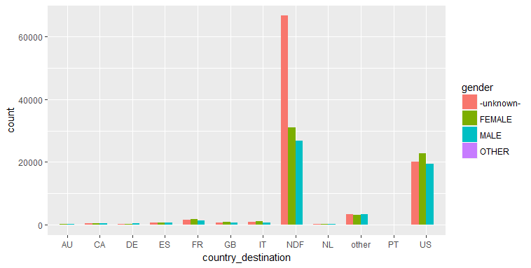
Identify NA’s and handle NA- Missing value imputation of gender

Slide 6
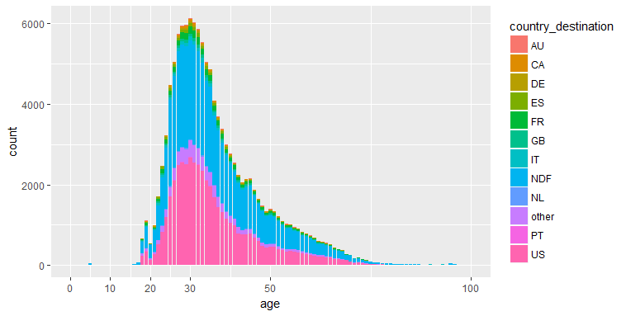
Identify NA’s and handle NA- Missing value imputation of age

Slide 7
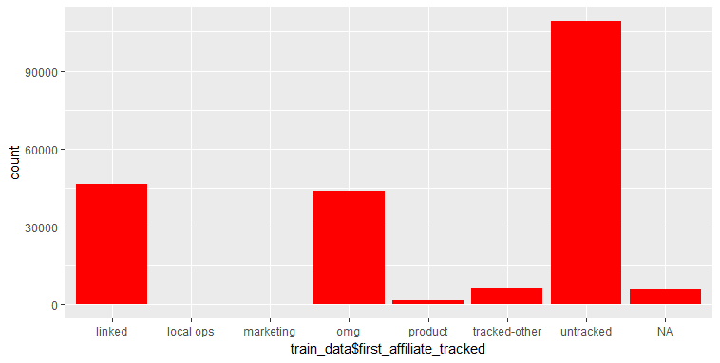
Identify NA’s and handle NA- Missing value imputation of first Affiliate tracked

Slide 8
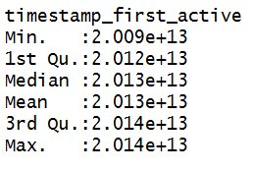
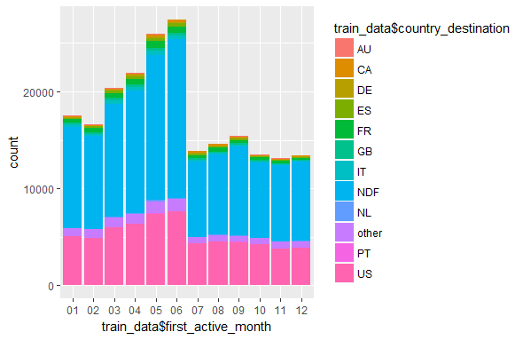
Feature Engineering – timestamp_first_active
Month extracted from the timestamp
Graph- Months binned into two groups

Slide 9
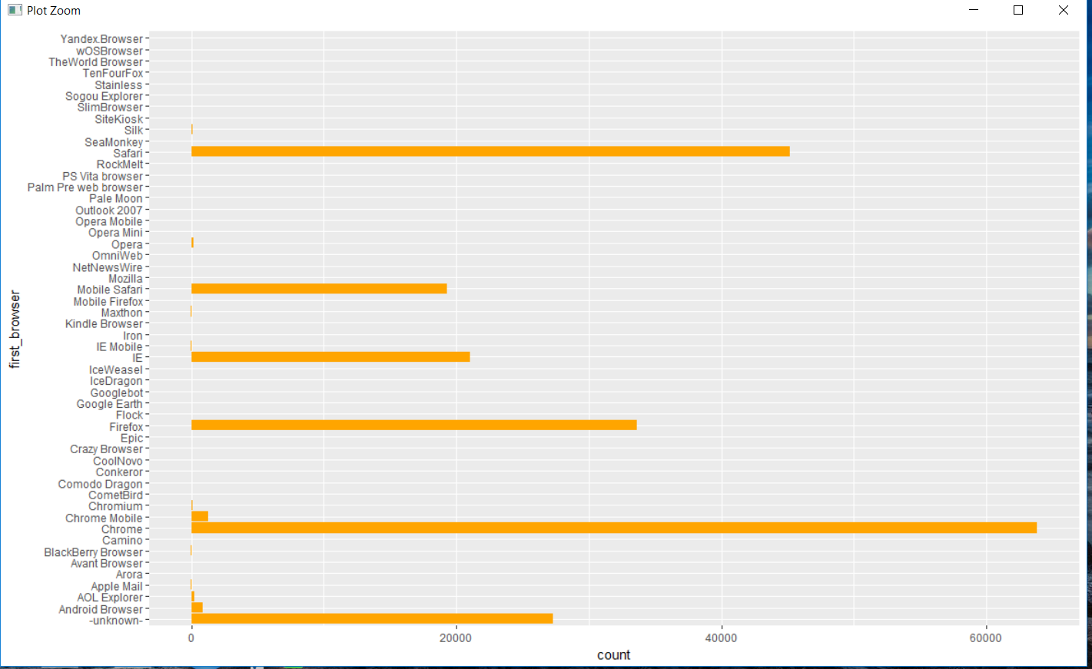
Feature Engineering – first_browser
Feature Engineering – first_browser

Slide 10
Feature Engineering –Merging multiple data sources
age-gender-bkts-
Used for NA value imputation for age attribute
sessions-
Derived new column-Total_elapsed_time from session

Slide 11
Naïve Bayes
Naïve Bayes is a generative model.
Naïve Bayes is a classification method based on probability theory.
The Naive Bayes algorithm describes a simple method to apply Bayes' theorem to classification problems.
Naive Bayes classifier assume that the effect of the value of a predictor (x) on a given class (c) is conditionally independent of the values of other predictors

Slide 12
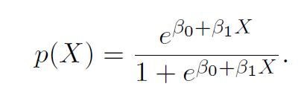
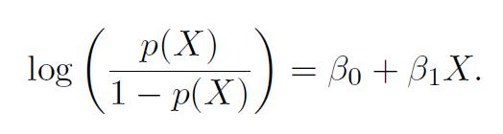
Multinomial Logistic Regression
It uses a maximum likelihood estimation rather than the least squares estimation used in traditional multiple regression.

Slide 13
Linear Discriminant Analysis
LDA makes some simplifying assumptions about your data:
1. That your data is Gaussian, that each variable is is shaped like a bell curve when plotted.
2. That each attribute has the same variance, that values of each variable vary around the mean by the same amount on average.
With these assumptions, the LDA model estimates the mean and variance from your data for each class. It is easy to think about this in the univariate (single input variable) case with two classes.

Slide 14
Classification Algorithm-
Naïve Bayes
Accuracy:0.532
Multinomial LR
Accuracy:0.606
LDA
Accuracy:0.67

Slide 15


